Slide 1
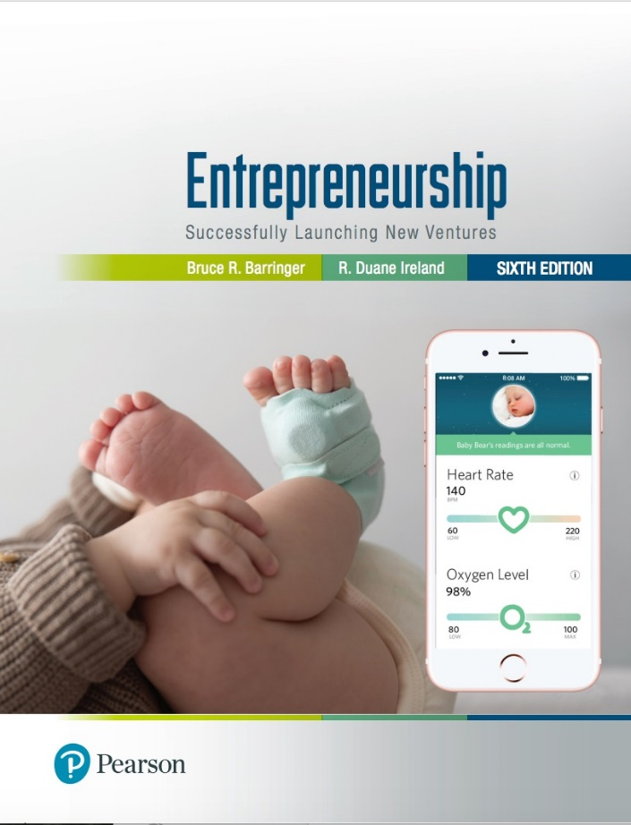
Entrepreneurship: Successfully Launching New Ventures
Sixth Edition
Chapter 15
Franchising
Notes:
If this PowerPoint presentation contains mathematical equations, you may need to check that your computer has the following installed:
1) MathType Plugin
2) Math Player (free versions available)
3) NVDA Reader (free versions available)

Slide 2
Learning Objectives (1 of 2)
15.1 Explain franchising and how this form of business ownership works.
15.2 Describe steps entrepreneurs can take to establish a franchise system.
15.3 Become familiar with the advantages and disadvantages of establishing a franchise system.
15.4 Describe actions and issues associated with a decision to buy a franchise.

Slide 3
Learning Objectives (2 of 2)
15.5 Explain the steps an entrepreneur goes through to buy a franchise.
15.6 Identify and explain the various legal aspects associated with the franchise relationship.
15.7 Discuss two additional issues—franchise ethics and international franchising—entrepreneurs should think about when considering franchising.

Slide 4
What is Franchising?
Franchising
Franchising is a form of business organization in which a firm that already has a successful product or service (franchisor) licenses its trademark and method of doing business to another business or individual (franchisee) in exchange for a franchise fee and an ongoing royalty payment.
Some franchisors are established firms (like McDonald’s) while others are first-time enterprises being launched by entrepreneurs (like Uptown Cheapskate).

Slide 5
Two Types of Franchise Systems (1 of 2)
Product and Trademark Franchise
An arrangement under which the franchisor grants to the franchisee the right to buy its products and use its trade name.
This approach typically connects a single manufacturer with a network of dealers or distributors.
For example, General Motors has established a network of dealers that sell GM cars and use the GM trademark in their advertising and promotions.
Other examples of product and trademark franchisors include agricultural machinery dealers, soft drink bottlers, and beer distributorships.

Slide 6
Two Types of Franchise Systems (2 of 2)
Business Format Franchise
An arrangement under which the franchisor provides a formula for doing business to the franchisee along with training, advertising, and other forms of assistance.
Fast-food restaurants, convenience stores, and motels are well-known examples of business format franchises.
Business format franchises are by far the most popular form of franchising, particularly for entrepreneurial firms.

Slide 7
Business Format Franchises
Table 15.1 10 Industries in Which Business Format Franchises Are Used Prominently
Automotive
Business Services
Commercial and Residential Services
Food Retailing
Lodging
Personal Services
Quick Serve Restaurants
Real Estate
Retail Products & Services
Table/Full-Service Restaurants

Slide 8
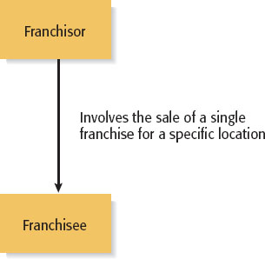
Types of Franchise Agreements (1 of 3)
Individual Franchise Agreement

Slide 9
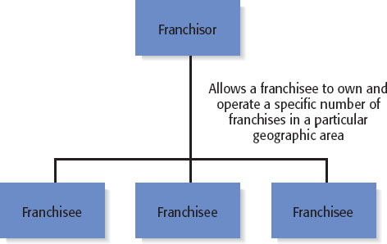
Types of Franchise Agreements (2 of 3)
Area Franchise Agreement

Slide 10
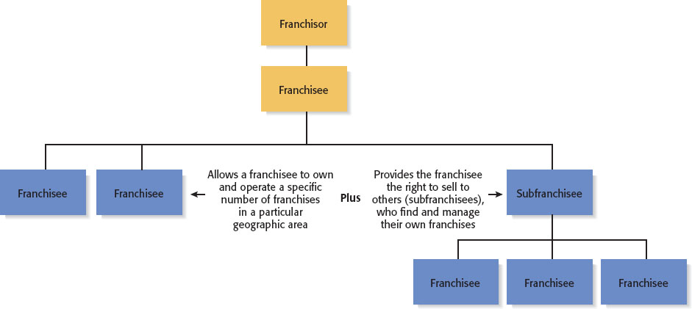
Types of Franchise Agreement (3 of 3)
Master Franchise Agreement

Slide 11
When to Franchise? (1 of 2)
When Is Franchising Most Appropriate?
Franchising is most appropriate when a firm has a strong or potentially strong trademark, a well-designed business method, and a desire to grow.
In some instances franchising is not appropriate.
For example, franchising works for Burger King but would not work for Walmart.
Each individual Burger King store is relatively small and policies and procedures can be written for almost any contingency.
In contrast, Walmart stores are much larger, more expensive to build, and more complex to run compared to Burger King. It would be nearly impossible for Walmart to find enough franchisees with the financial capital and expertise to open and successfully operate a Walmart store.

Slide 12
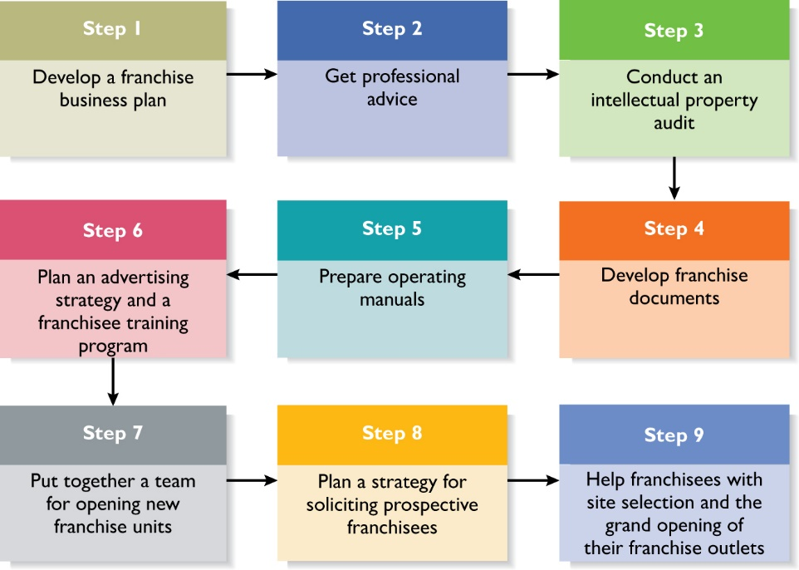
When to Franchise? (2 of 2)
Figure 15.2 Nine Steps in Setting Up a Franchise System

Slide 13
Selecting and Developing Effective Franchisees (1 of 2)
Table 15.2 Qualities to Look for in Prospective Franchisees
Good work ethic
Ability to follow instructions
Ability to operate with minimal supervision
Team oriented
Experience in the industry in which the franchise competes
Adequate financial resources and good credit history
Ability to make suggestions without becoming confrontational or upset if the suggestions are not adopted
Ability to represent the franchisor in a positive manner

Slide 14
Selecting and Developing Effective Franchisees (2 of 2)
Table 15.2 Ways Franchisors Can Develop Their Franchisees’ Potential
Provide mentoring that supersedes routine training
Keep operating manuals up-to-date
Keep product, services, and business systems up-to-date
Solicit input from franchisees to reinforce their importance in the larger system
Encourage franchisees to develop a franchise association
Maintain the franchise system’s integrity

Slide 15
Advantages and Disadvantages of Establishing a Franchise System (1 of 2)
There are two primary advantage of franchising.
First, early in the life of an organization, capital is typically scarce. Franchising helps a venture grow quickly because franchisees provide the majority of the capital.
Second, a concept called agency theory argues that for organizations with multiple units, it is more effective for the units to be run by franchisees than by managers who run company-owned stores.
The theory is that managers, because they are paid a salary, may not be as committed to the success of their individual units as franchisees, who are in effect business owners.

Slide 16
Advantages and Disadvantages of Establishing a Franchise System (2 of 2)
Table 15.3 Advantages and Disadvantages of Franchising as a Method of Business Expansion
Advantages | Disadvantages
Rapid, low-cost market expansion. Income from franchise fees and royalties. Franchisee motivation. Access to ideas and suggestions. Cost savings. Increased buying power. | Profit sharing. Loss of control. Friction with franchisees. Managing growth. Differences in required business skills. Legal expenses.

Slide 17
Buying a Franchise (1 of 4)
From the Franchisee’s Point of View
Purchasing a franchise is an important business decision involving a substantial financial commitment.
Potential franchise owners should strive to be as well informed as possible before purchasing a franchise and should be aware that it is often legally and financially difficult to exit a franchise relationship.
Franchising may be a particularly good choice for someone who wants to start a business but has no prior business experience.
Many franchise systems provide their franchisees substantial training and support.

Slide 18
Buying a Franchise (2 of 4)
Answering the following questions will help determine if franchising is right for you:
Are you willing to take orders? Franchisors are typically very particular about how outlets operate.
Are you willing to be part of a franchise “system” rather than be an independent businessperson?
How will you react if you make a suggestion to your franchisor and your suggestion is rejected?
What are you looking for in a business? How hard do you want to work?

Slide 19
Buying a Franchise (3 of 4)
How willing are you to put your money at risk? How will you feel if your business is operating at a net loss but you still have to pay royalties on your gross income?

Slide 20
Buying a Franchise (4 of 4)
Table 15.6 Advantages and Disadvantages of Buying a Franchise
Advantages | Disadvantages
A proven product or service within an established market. An established trademark or business system. Franchisor’s training, technical expertise, and managerial expertise. An established marketing network. Franchisor’s ongoing support. Availability of financing. Potential for business growth. | Cost of the franchise. Restrictions on creativity. Duration and nature of the commitment. Risk of fraud, misunderstandings, or lack of franchisor commitment. Problems of termination or transfer. Poor performance on the part of other franchisees. Potential for failure.

Slide 21
The Cost of a Franchise (1 of 4)
Initial Franchise Fee
The initial fee varies depending on the franchisor.
Capital Requirements
The costs vary but may include the cost of buying real estate, the cost of putting up a building, the purchase of inventory, and the cost of obtaining a business license.
Continuing Royalty Payment
Is usually around 5% of monthly gross income.

Slide 22
The Cost of a Franchise (2 of 4)
Advertising Fees
Franchisees are often required to pay into a national or regional advertising fund.
Other Fees
Other fees may be charged for various activities, including:
Training additional staff.
Providing management expertise when needed.
Providing computer assistance.
Providing a host of other items or support services.

Slide 23
The Cost of a Franchise (3 of 4)
Table 15.4 Initial Costs to the Franchisee of a Sample of Franchise Organizations
Franchise Organization | Year Started Franchising | Company- Owned Units | Franchised Units | Franchise Fee | Ongoing Royalty Fee | Total Initial Investment
Anytime Fitness | 2002 | 38 | 3,386 | $19,000-- $37,500 | $449-$549/month | $80,020--$490,100
Budget Blinds | 1994 | 0 | 1,087 | $19,950 | Varies | $99,240–$202,070
Edible Arrangements | 2001 | 8 | 1,245 | $30,000 | 5% | $196,610--$327,810
Hampton Inn Hotels | 1984 | 1 | 2,148 | $75,000 | 6% | $4.2--$14.9 million
Liberty Tax Service | 1973 | 351 | 3,753 | $40,000 | 14% | $58,700--$71,900

Slide 24
The Cost of a Franchise (4 of 4)
Table 15.4 (continued)
Franchise Organization | Year Started Franchising | Company- Owned Units | Franchised Units | Franchise Fee | Ongoing Royalty Fee | Total Initial Investment
Pinkberry | 2006 | 33 | 242 | $35,000 | 6% | $310,842—$615,145
Play It Again Sports | 1988 | 0 | 285 | $25,000 | 5% | $240,300--$397,200
Qdoba Mexican Grill | 1997 | 359 | 330 | $30,000 | 5% | $851,600--$1.13 million
The UPS Store | 1980 | 0 | 4,910 | $29,950 | 5% | $159,224--$434,521
Wetzel’s Pretzels | 1996 | 9 | 294 | $35,000 | 7% | $164,950--$405,850
Source: Based on Entrepreneur.com, www.entrepreneur.com (accessed March 21, 2017).

Slide 25
Steps in Purchasing a Franchise (1 of 2)
The first rule of buying a franchise is to avoid making a hasty decision.
Owning a franchise is typically costly and labor-intensive. As a result, the purchase of a franchise should be a careful, deliberate decision.
Purchasing a franchise system is a seven-step process, as illustrated in the following slide.

Slide 26
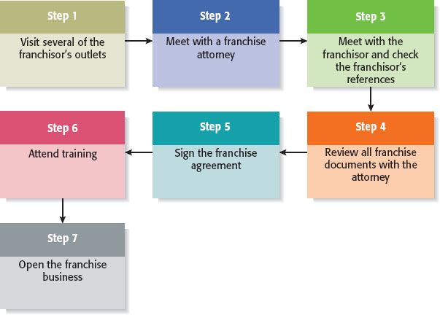
Steps in Purchasing a Franchise (2 of 2)
Figure 15.3 Seven Steps in Purchasing a Franchise

Slide 27
Watch Out! Common Misconceptions about Franchising
Franchising is a safe investment.
A strong industry ensures franchise success.
A franchise is a “proven” business system.
There is no need to hire a franchise attorney or an accountant.
The best systems grow rapidly, and it is best to be part of a rapid-growth system.
I can operate my franchise outlet for less than the franchisor predicts.
The franchisor is a nice person—he’ll help me out if I need it.

Slide 28
Legal Aspects of the Franchise Relationship
Federal Rules and Regulations
The offer and sale of a franchise are regulated at the federal level.
According to Federal Trade Commission (FTC) rule 436, franchisors must furnish potential franchisees with written disclosures that provide information about the franchisor, the franchised business, and the franchise relationship.
In most cases, the disclosures are made through a lengthy document referred to as the Franchisor Disclosure Document (FDD).
The FDD contains 23 categories of information that give a prospective franchisee a broad base of information about the background and financial health of the franchisor.

Slide 29
More About Franchising (1 of 3)
Franchise Ethics
The majority of franchisors and franchisees are highly ethical.
There are certain features of franchising, however, that make it subject to ethical abuse. These features are as follows:
The get-rich-quick mentality.
The false assumption that buying a franchise is a guarantee of business success.
Conflicts of interest between franchisors and franchisees.

Slide 30
More About Franchising (2 of 3)
International Franchising
International opportunities for franchising are becoming more prevalent for the following two reasons:
The markets for certain franchised products in the U.S. have become saturated (i.e., fast food).
The trend toward globalization continues.

Slide 31
More About Franchising (3 of 3)
International Franchising (continued)
Steps to take before buying a franchise overseas:
Consider the value of the franchisor’s name in the foreign country.
Work with a knowledgeable lawyer.
Determine whether the product or service is saleable in a foreign country.
Uncover whether the franchisor has experience in international markets.
Find out how much training and support you will receive from the franchisor.

Slide 32

Copyright

